Slide 1
MSc AI Dissertation proposal Sustainable Crop Yield prediction via Multi-modal AI

Slide 2
Background :- raditional crop yield models often rely on a single data modality, failing to capture the complex relationship between spatial vegetation health and temporal weather patterns Aims :- To design a robust AI framework that integrates heterogeneous data sources to improve the accuracy and reliability of agricultural forecasts.
Research Questions :-
How does fusing pixel-level imagery with tabular climate data reduce error
Which fusion strategy (Early vs Late) maximizes robustness
Contextual Novelty :- Current models rely on single novelties, missing the complex interplay between spatial vegetation health and temporal climate variables

Slide 3
METHODOLOGY Rationale :- Multimodal fusion allows for a more holistic understanding of the agricultural environment than single-stream models.
Dataset :- CropNet dataset
Sentinel 2:- Multi-spectral imagery (RGB +NDVI)
WRF-HRR :- High resolution weather-time series
USDA Yield:- Ground-truth harvest data
Analaytical process:-
Preprocessing: Spatial alignment of satellite pixels to weather grids and normalization of indices like NDVI.
Evaluation: Performing ablation studies to determine the individual contribution of each data modality.

Slide 4
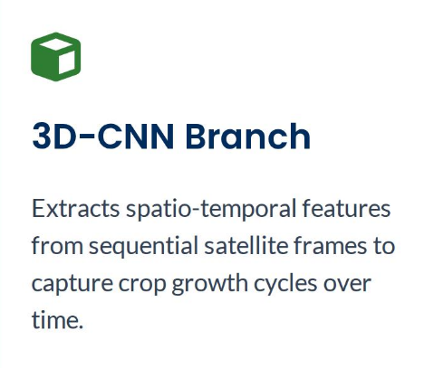
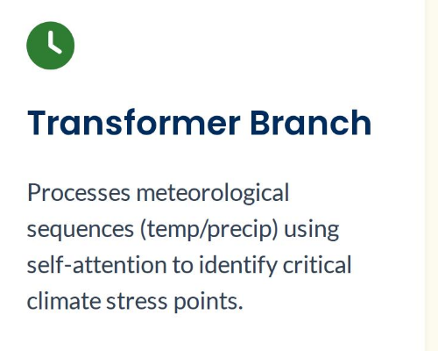
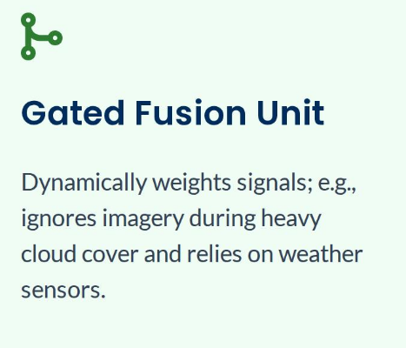
Theoretical Deep Learning Framework

Slide 5
Steps to take:-
STEP 1:- Preprocessing and analyzing data using CropNet dataset
STEP 2:- Baseline model training (Uni-modal CNN vs LSTM)
STEP 3:- Construction of the Multimodal Fusion layers and execution of the comparative experiments.
STEP 4:- Evaluation and stress testing

